Slide 1
POWER BI PROJECT
STARBUCKS CUSTOMER
ORDERING PATTERN ANALYSIS
Analyzing Customer Orders, Sales Trends and Customer Satisfaction using Power BI
Prepared by: Gokila

Slide 2
Introduction
Starbucks generates customer orders through different ordering channels.
Customer ordering behavior can vary based on time, drink category, age group and membership.
This project analyzes Starbucks customer ordering data to identify important sales and customer behavior patterns.
Power BI is used to transform the raw data into an interactive dashboard.
The dashboard helps to understand sales performance, ordering trends and customer satisfaction.
2

Slide 3
Problem Statement
Starbucks receives a large number of customer orders through different channels every day. It is difficult to understand customer ordering behavior, spending patterns, peak ordering times, and customer satisfaction from raw data. This project analyzes Starbucks customer order data using Power BI to identify important sales and customer behavior patterns. The insights can help Starbucks improve sales performance, operational efficiency, and customer experience.
Starbucks Customer Ordering Pattern Analysis
3

Slide 4
Raw Data Analysis
The raw dataset contains order-level customer information.
Customer age group
IMPORTANT COLUMNS
CUSTOMER-RELATED
INFORMATION
order_id Unique ID for each order
drink_category Category of the drink
Customer age group
customer_id Identifies the customer
total_spend Amount spent on the order
Customer gender
Rewards membership status
store_id Identifies the Starbucks store
cart_size Number/size of items in the order
order_date Date when the order was placed
num_customizations Number of customizations
DERIVED DATE COLUMNS
order_hour Hour when the order was placed
fulfillment_time_min Time taken to fulfill the order
Year • Month • Month Number • Quarter • Day of Week • Order Hour
order_channel Channel used for ordering
customer_satisfaction Customer satisfaction score
4

Slide 5
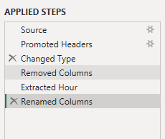
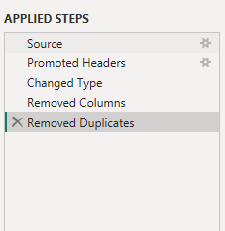
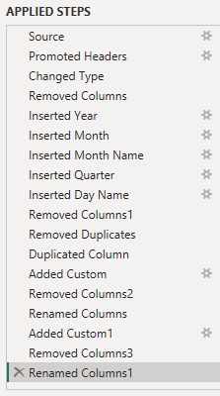
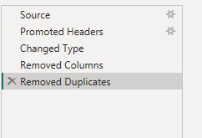
Data Preprocessing
1
Checked data types
2
Checked missing values
3
Removed duplicate records
4
Created date-related columns
5
Created Order Hour
6
Prepared data for modelling
7
5

Slide 6
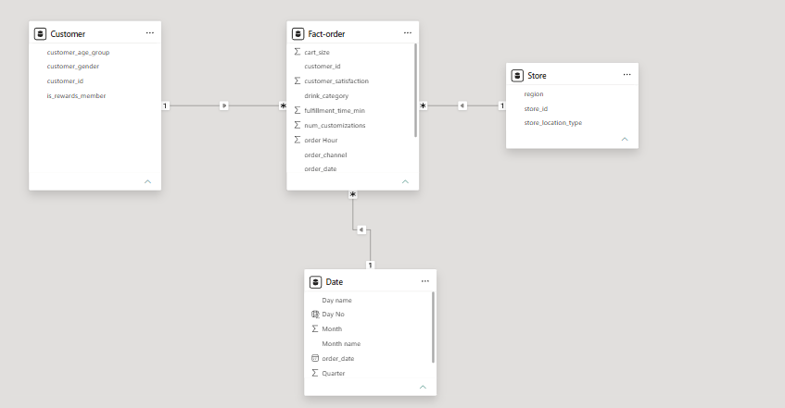
Data Modelling — Star Schema
Dim_Customer
Dim_Store
store_id,
store location type,
Region.
Fact_Order
(ata)
Dim_Produc
Dim_Date
date, year, month,
quarter, day name
6

Slide 7
Relationships & Cardinality
Dim_Customer
(One customer)
“One customer can place many orders. Therefore, the relationship between the customer dimension and fact table is one-to-many.”
WHY STAR SCHEMA?
Easy to understand
Better organized
Makes analysis easier
Helps create efficient Power BI reports
1 : Many
Fact_Order
(Many orders)
Starbucks Customer Ordering Pattern Analysis
7

Slide 8
Slicers & Filters
Five slicers were added: Year, Month, Order Channel, Drink Category, and Rewards Member.
Slicers let users filter the entire dashboard to a specific segment instantly.
Example: selecting 2025 in the Year slicer updates every chart to show only 2025 data.
Example: selecting Mobile App shows performance for that channel alone.
This makes the dashboard exploratory — not just a static report.
FILTERS PANEL
Year
All ▾
Month
All ▾
Order Channel
All ▾
Drink Category
All ▾
Rewards Member
All ▾
Starbucks Customer Ordering Pattern Analysis
8

Slide 9
KPI Metrics
KPI cards give a quick overview of overall business performance.
TOTAL REVENUE
TOTAL ORDERS
AVG ORDER VALUE
AVG SATISFACTION
AVG FULFILLMENT TIME
14.9M
100K
$14.87
4.55
3.99
Total amount generated from orders
Total number of orders placed
Average amount spent per order
Average customer satisfaction score
Average time to complete an order
KPI QUESTIONS
What is the total revenue?
How many orders were placed?
What is the average order value?
What is the average satisfaction?
What is the average fulfillment time?
Starbucks Customer Ordering Pattern Analysis
9

Slide 10
Business Questions
Q1
Which drink category generates the highest total revenue?
Q2
Which order channel contributes the highest sales?
Q3
At what hour are the highest number of orders placed?
Q4
How do monthly sales trends compare between 2024 and 2025?
Q5
Which day of the week generates the highest revenue?
Q6
Which customer age group spends the most on Starbucks orders?
Q7
Does Starbucks Rewards Membership influence customer spending?
Q8
How does fulfillment time impact customer satisfaction?
Starbucks Customer Ordering Pattern Analysis
10

Slide 11
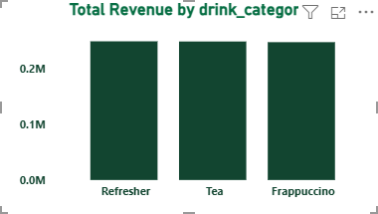
Q1 Which drink category generates the highest total revenue?
Starbucks Customer Ordering Pattern Analysis
11

Slide 12
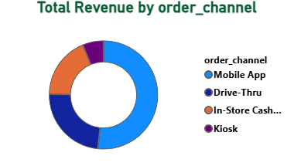
Q2 Which order channel contributes the highest sales?
Starbucks Customer Ordering Pattern Analysis
12

Slide 13
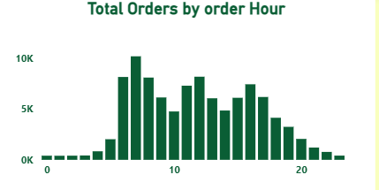
Q3. At what hour are the highest number of orders placed?
Starbucks Customer Ordering Pattern Analysis
13

Slide 14
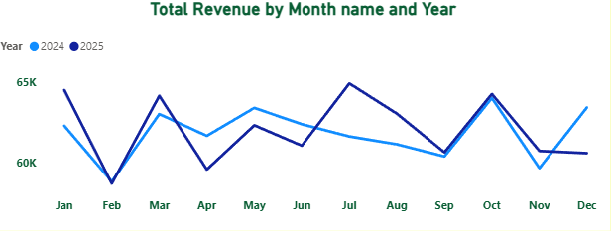
Q4. How do monthly sales trends compare between 2024 and 2025?
Starbucks Customer Ordering Pattern Analysis
13

Slide 15
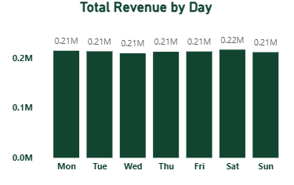
Q5. Which day of the week generates the highest revenue?
Starbucks Customer Ordering Pattern Analysis
13

Slide 16
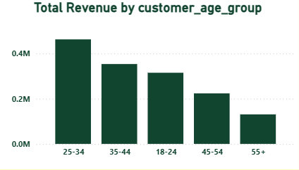
Q6. Which customer age group spends the most on Starbucks orders?
Starbucks Customer Ordering Pattern Analysis
13

Slide 17
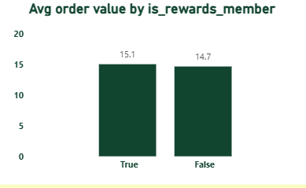
Q7. Does Starbucks Rewards Membership influence customer spending?
Starbucks Customer Ordering Pattern Analysis
13

Slide 18
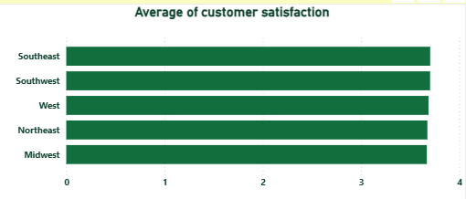
Q8. How does fulfillment time impact customer satisfaction?
Starbucks Customer Ordering Pattern Analysis
13

Slide 19
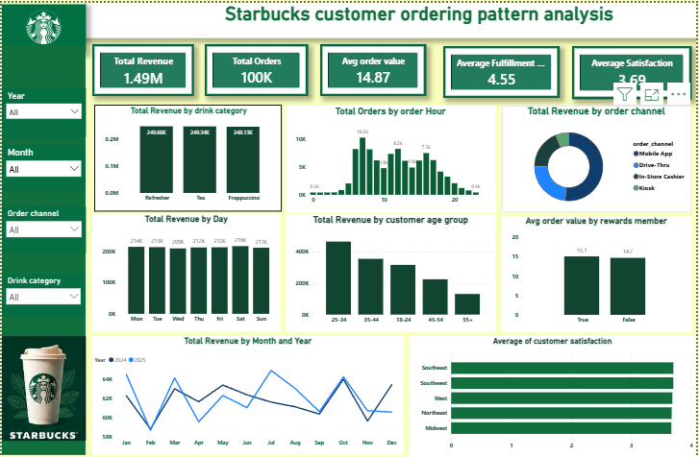
Interactive Power BI Dashboard
📊
Insert your full dashboard screenshot here
(Take a screenshot of your Power BI report page and paste it into this box)
The dashboard combines KPIs, charts and slicers into a single interactive report to provide a clear view of Starbucks customer ordering patterns.
Starbucks Customer Ordering Pattern Analysis
15

Slide 20
Conclusion
This project successfully analyzed Starbucks customer ordering patterns using Power BI. The analysis provides insights into revenue, orders, customer demographics, ordering channels, rewards membership and customer satisfaction. The interactive dashboard makes it easier to identify important trends and supports data-driven business decision-making.
Starbucks Customer Ordering Pattern Analysis
17

Slide 21
THANK YOU

